Slide 1
Teachnook
Minor project

Slide 2
Cryptography Cipher
By Pathan Humamkhan HaiderKhan

Slide 3
Index
What Is Cipher
Types of cipher
Implemantations
conclution

Slide 4
What cryptography cipher
In cryptology, the discipline concerned with the study of cryptographic algorithms, a cipher is an algorithm for encrypting and decrypting data. Symmetric key encryption, also called secret key encryption, depends on the use of ciphers, which operate symmetrically.

Slide 5
Types of Ciphers
Subsititution Cipher
Transposition cipher
Permulation cipher
Playfair cipher
Private key cipher
Public key cipher

Slide 6
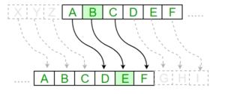
Substition cipher
Substitution ciphers. Replace bits, characters, or character blocks in plaintext with alternate bits, characters or character blocks to produce ciphertext. A substitution cipher may be monoalphabetic or polyalphabetic:

Slide 7
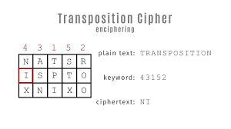
Transposition cipher
Unlike substitution ciphers that replace letters with other letters, transposition ciphers keep the letters the same, but rearrange their order according to a specific algorithm. For instance, in a simple columnar transposition cipher, a message might be read horizontally but would be written vertically to produce the ciphertext.

Slide 8
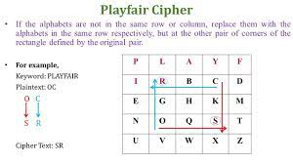
Playfair cipher
Substituting one letter for another letter, a polygraphic cipher performs substitutions with two or more groups of letters. This masks the frequency distribution of letters, making frequency analysis attacks much more difficult.

Slide 9
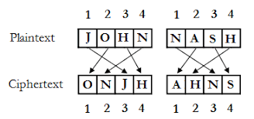
Permulation cipher
In this cipher, the positions held by plaintext are shifted to a regular system so that the ciphertext constitutes a permutation of the plaintext.

Slide 10
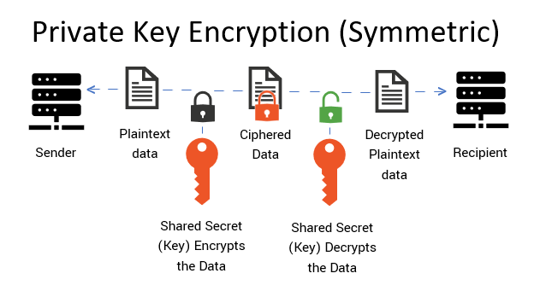
Private-key cryptography
In this cipher, the sender and receiver must have a pre-shared key. The shared key is kept secret from all other parties and is used for encryption, as well as decryption. This cryptography is also known as "symmetric key algorithm.

Slide 11
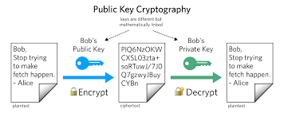
Public-key Cryptography
In this cipher, two different keys -- public key and private key -- are used for encryption and decryption. The sender uses the public key to perform the encryption, but the private key is kept secret from the receiver. This is also known as "asymmetric key algorithm."

Slide 12

implementation of Cipher in Kali linux
ccrypt is a utility for encrypting and decrypting files and streams. It was designed as a replacement for the standard unix crypt utility, which is notorious for using a very weak encryption algorithm. ccrypt is based on the Rijndael cipher, which is the U.S. government’s chosen candidate for the Advanced Encryption Standard (AES, see http://www.nist.gov/aes). This cipher is believed to provide very strong security.

Slide 13
Conclusion
Cryptography Encryption technique can guard the information and communication from unauthorized revelation and access of information. Authentication − The cryptographic techniques such as MAC and digital signatures can protect information against spoofing and forgeries.

